Slide 1
Meet 0925
王福恩

Slide 2
Outline
Implementation of 3D Bounding Box Estimation
oToBrite Project

Slide 3
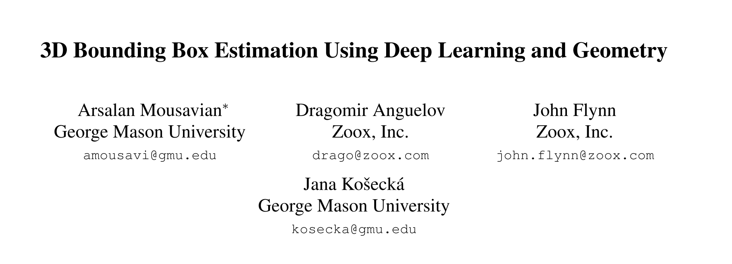

Slide 4

3D Box Definition
R = $\left[θ, ∅, α\right]$, Rotation
T = [$t_{x}{, t}_{y}, t_{z}$], Translation
D = [$d_{x}{, d}_{y}, d_{z}$], Dimension

Slide 5
Orientation Problem

Slide 6
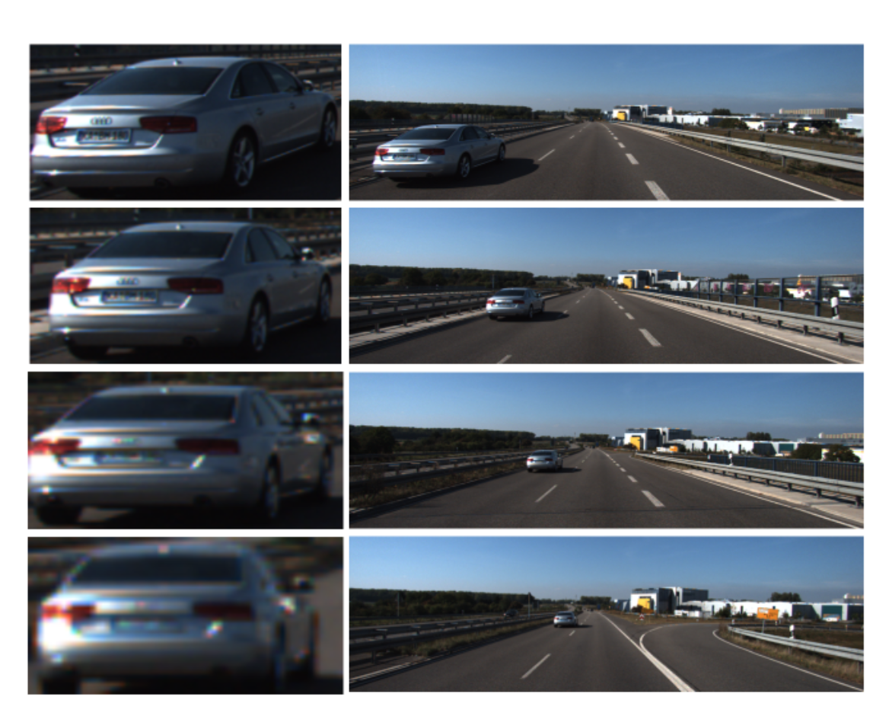
Orientation

Slide 7
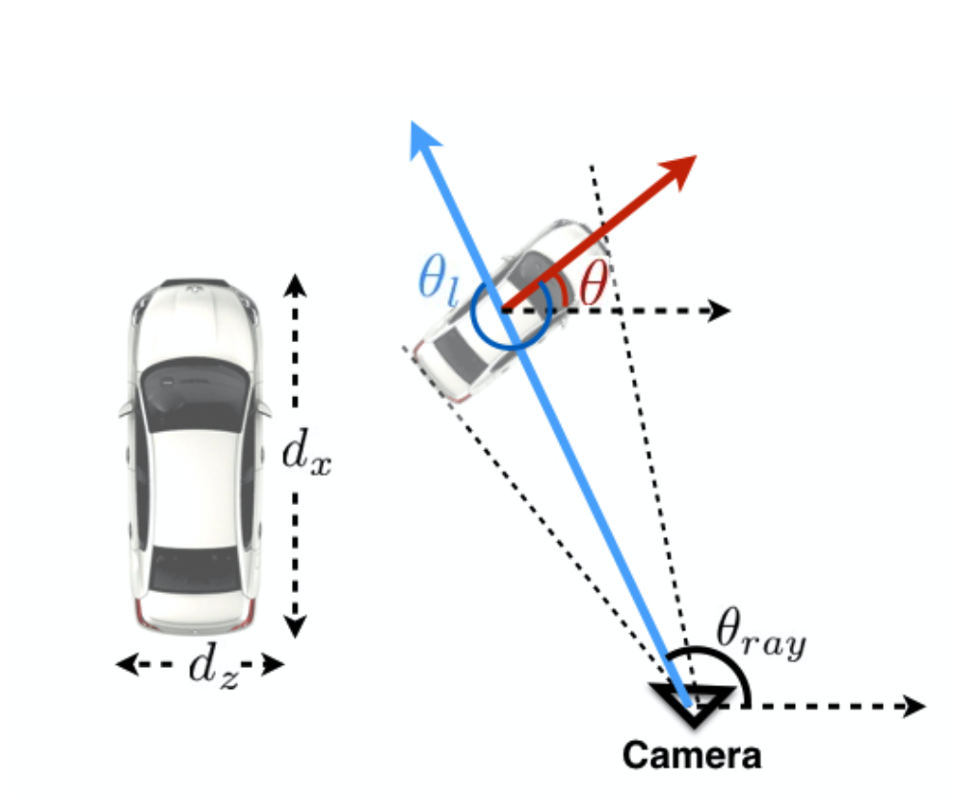

Orientation
$$θ= θ_{ray+ }θ_{l}$$

Slide 8
Procedure
Predict Orientation
Predict Dimension
Solve Translation
Low variance between each category
Solve linear system
Fatal to 3D Box

Slide 9
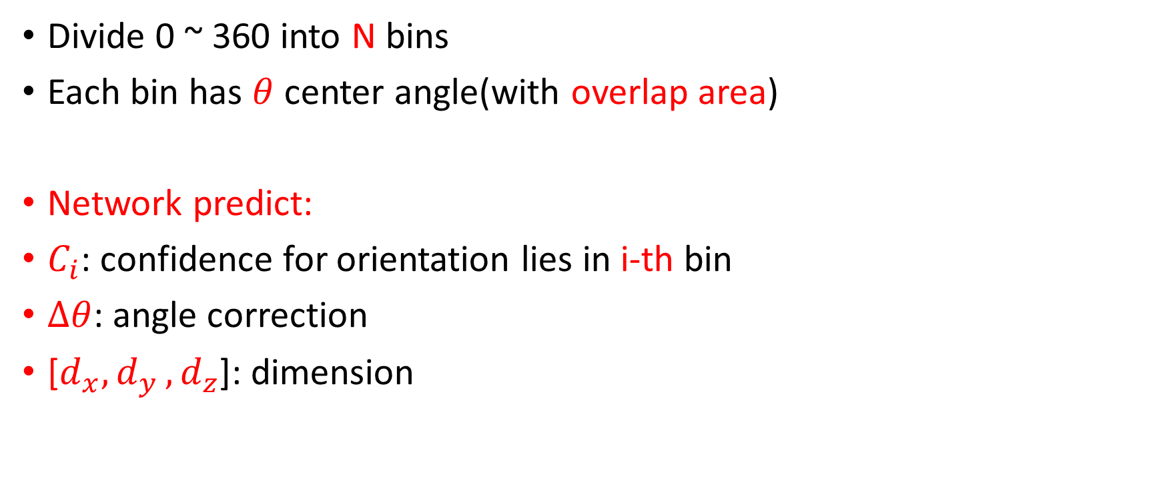
MultiBin Architecture
Divide 0 ~ 360 into N bins
Each bin has $θ$ center angle(with overlap area)
Network predict:
$C_{i}$: confidence for orientation lies in i-th bin
$∆θ$: angle correction
[$d_{x}{, d}_{y}, d_{z}$]: dimension

Slide 10
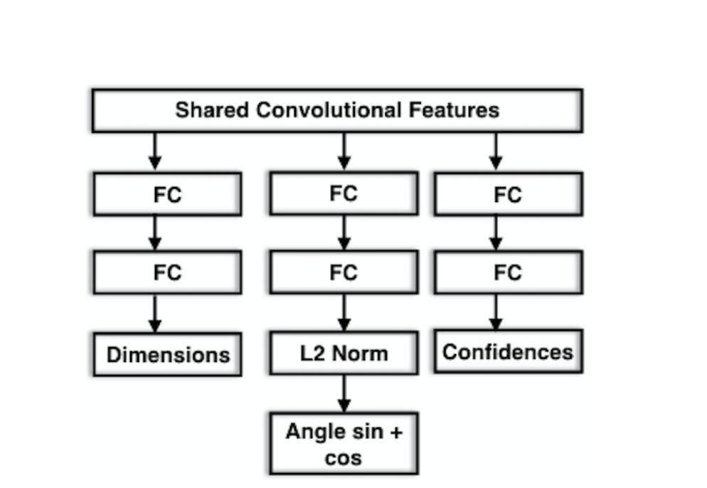
Network
VGG without FC

Slide 11
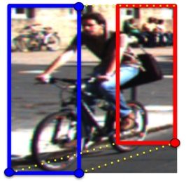
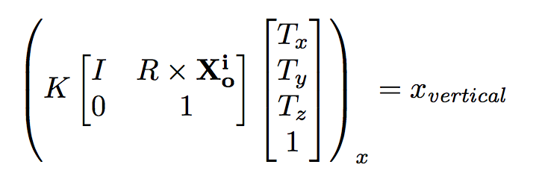
Translation
For vertical side of the 2D detection box
[±dx/2, .,±dz/2]
For horizontal side of the 2D detection box
[.,±dy/2,±dz/2]

Slide 12
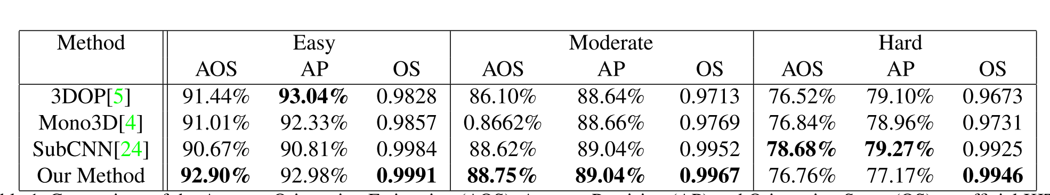
Orientation

Slide 13
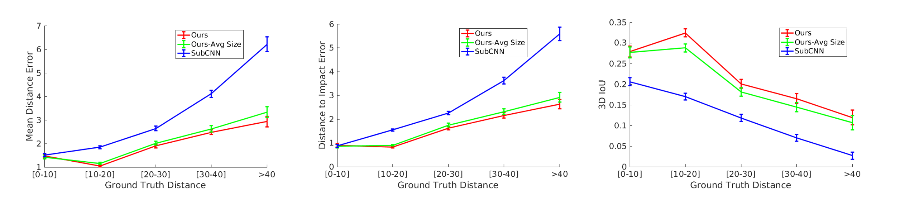
3D Bounding Box

Slide 14
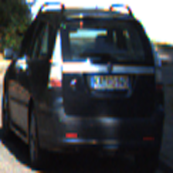
3D Bounding Box Estimation
3D bounding box initialization in 家盛‘s tool.
Total 7481 images and 40570 crop patches
35570 for training
5000 for validation

Slide 15
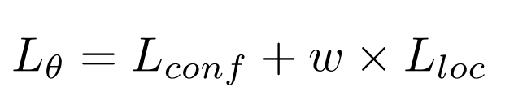
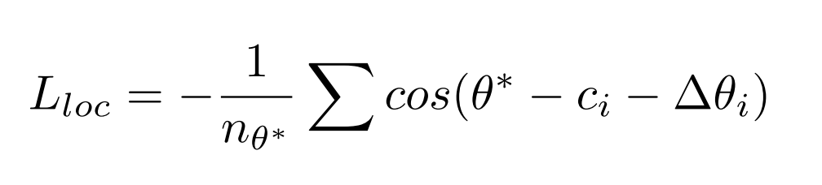
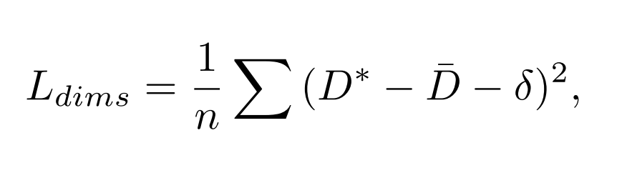

Slide 16
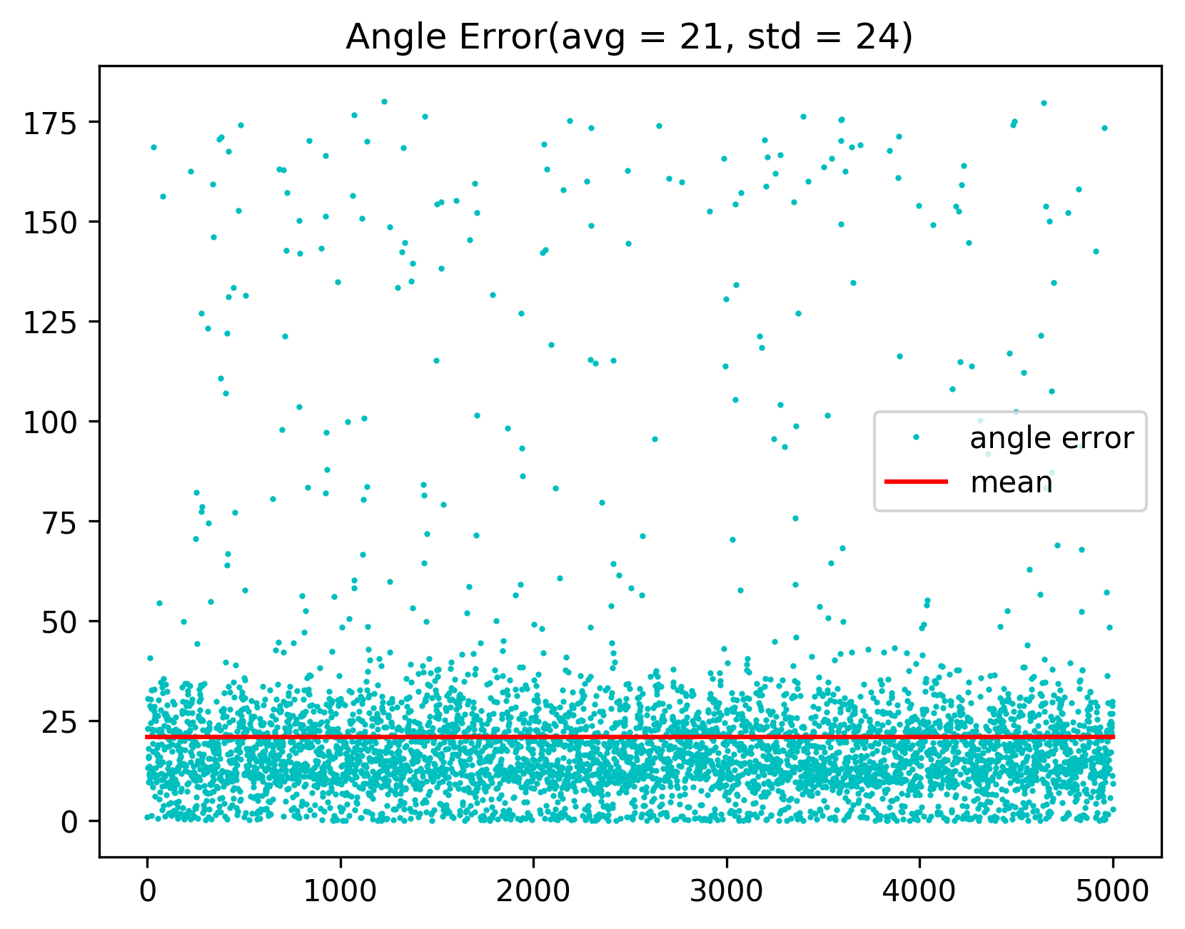

Slide 17
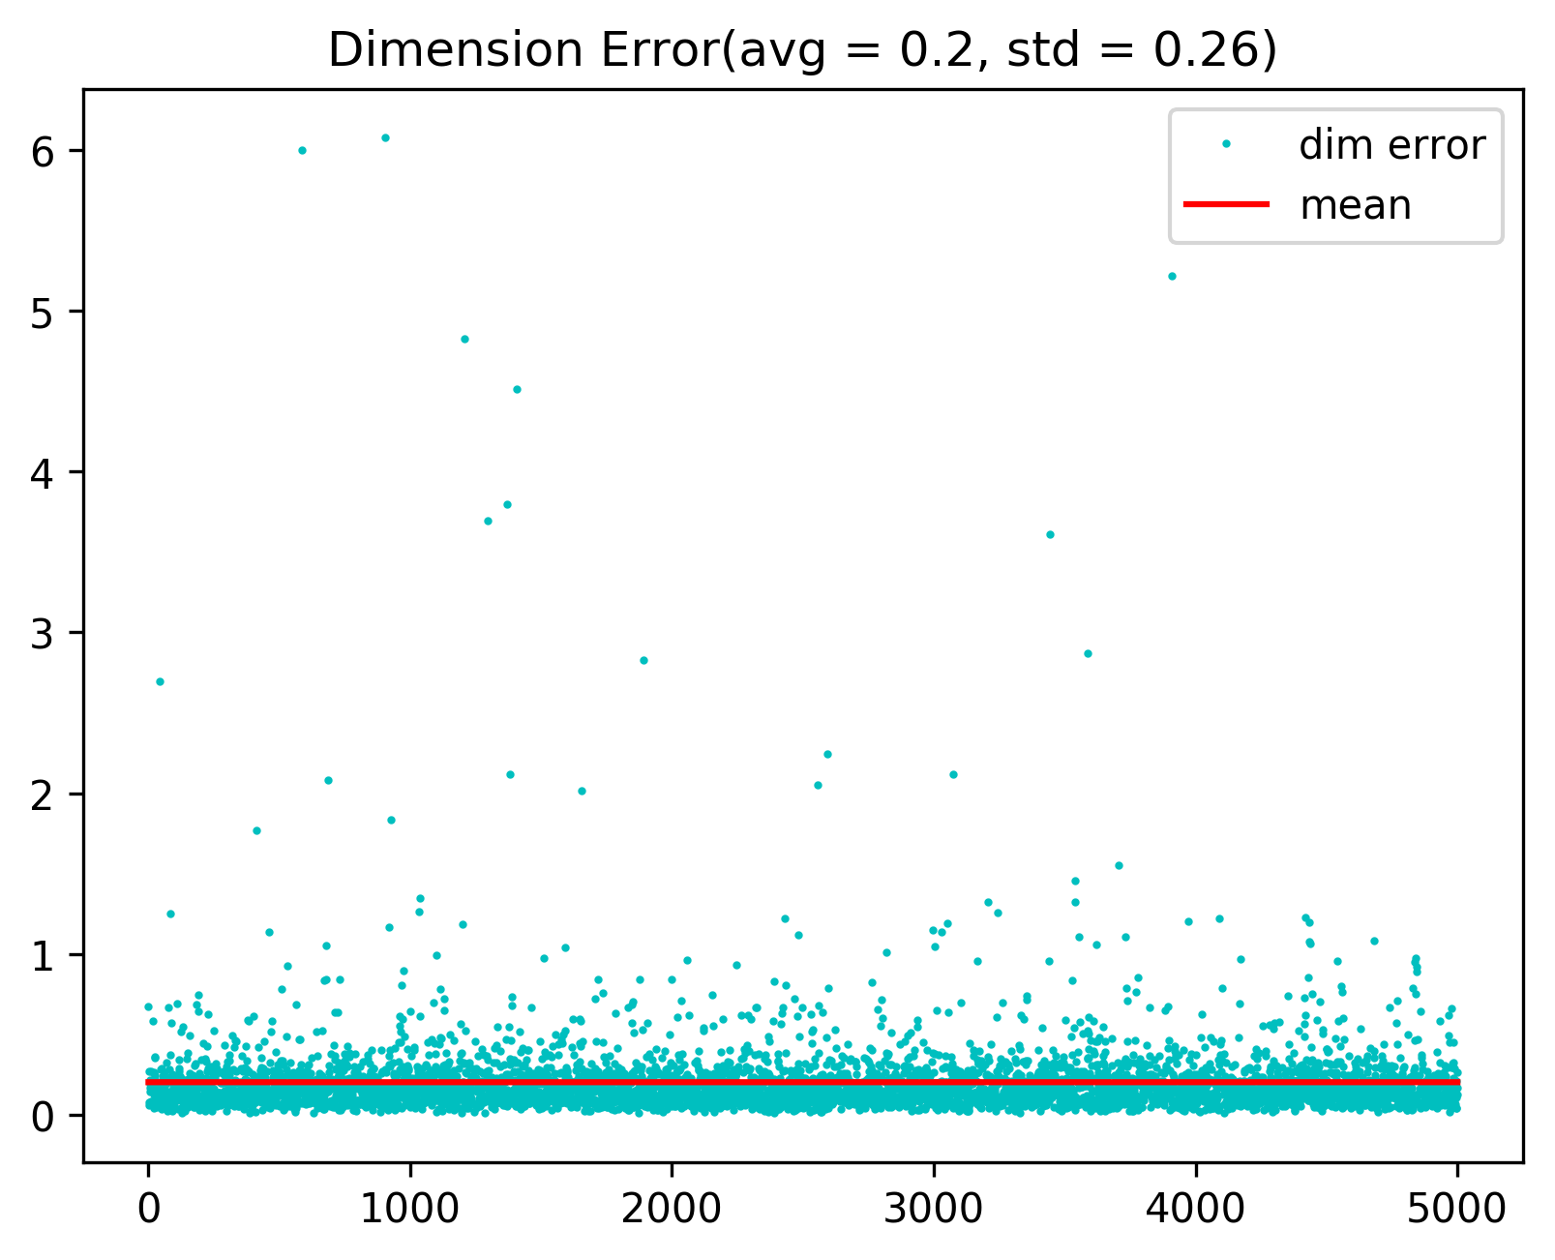

Slide 18
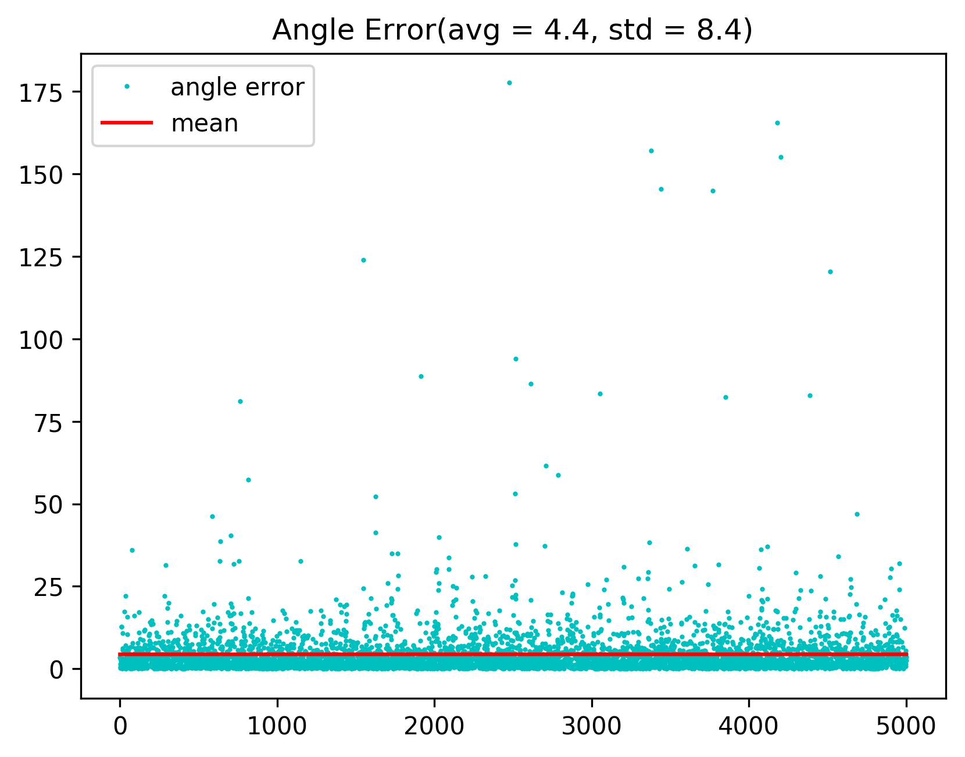
Training Set

Slide 19
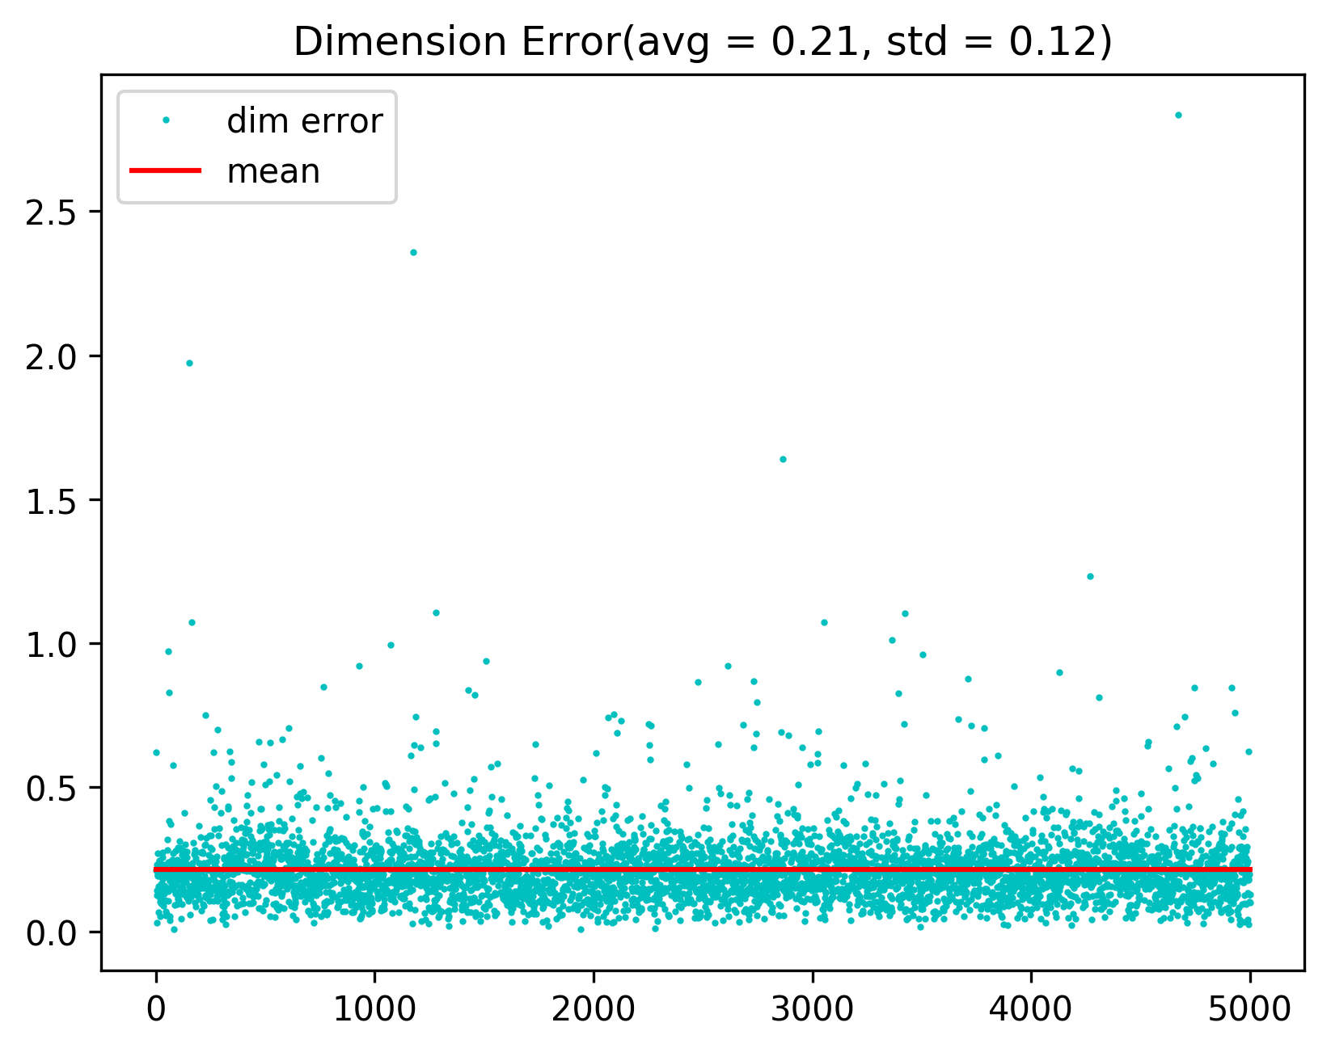
Training Set
Notes:
Survey GTAV related work(planning operation)

Slide 20
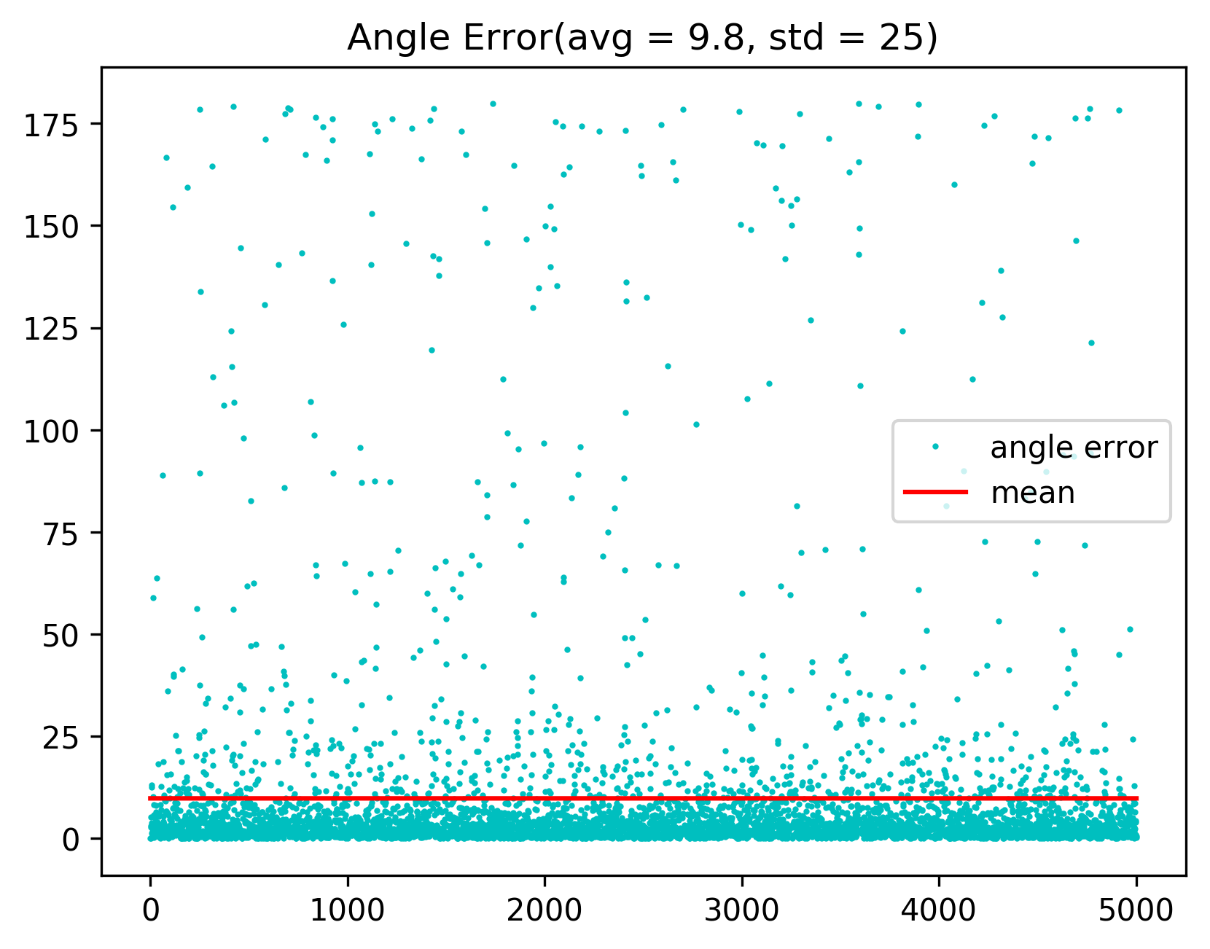
Eval Set

Slide 21
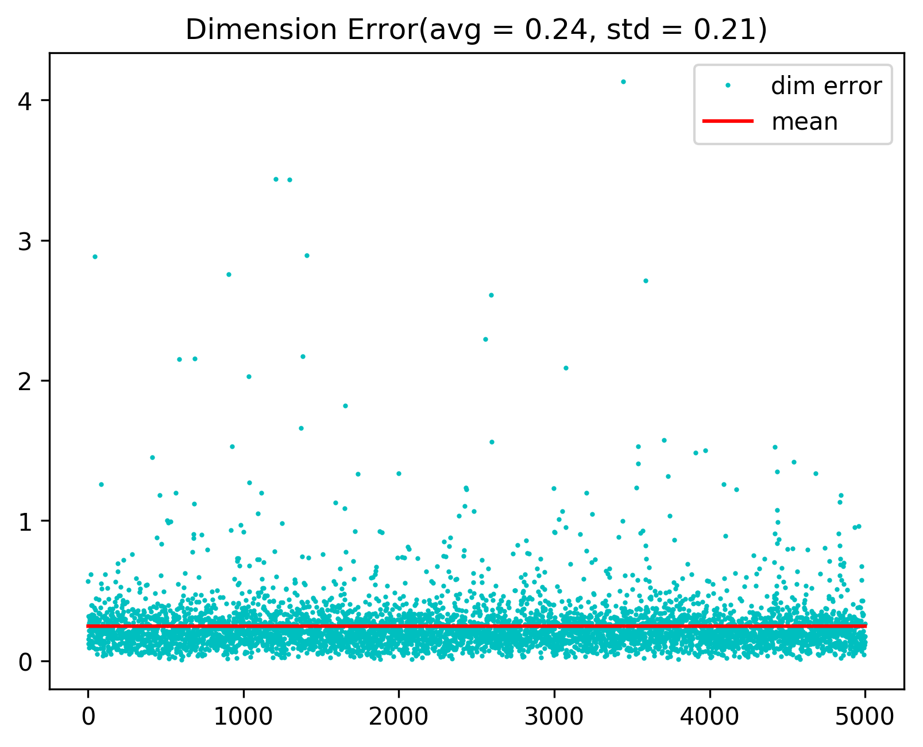
Eval Set

Slide 22
oToBrite
Remote sensing dataset
Bird’s eye view semantic segmentation
3D Reconstruction by Structure from Motion

